Slide 1


Case Study: Optimizing Radioactive Waste Management using Artificial intelligence
Team members:
B M LOKESHA
A MALLIKARJUNA
B Y SANJAY
Y BASAVARAJ
Date : 21/02/2025
Notes:
1

Slide 2
Dataset Overview :
A radioactive waste dataset includes key information on the type, quantity, and isotopes of waste generated from nuclear power, medical, and industrial activities. It categorizes waste into low-level, intermediate-level, and high-level waste. The dataset tracks the isotopes present, their half-lives, and radiation types (alpha, beta, gamma). It records storage methods (e.g., dry cask storage, geological repositories) and disposal sites. Regulatory compliance, safety measures, and environmental impacts are detailed, along with monitoring protocols. Timeframes of decay and projected risks are included, alongside historical data on waste generation. Geographical data for disposal sites and transportation routes is captured. It also includes financial aspects of waste management. The dataset supports global comparisons and cross-border waste management practices.
Sources :
https://www.kaggle.com/datasets/prottoymushfiq/radioactive-waste-management

Slide 3
Problem Statement
Brief Overview:
Radioactive waste management poses significant challenges in terms of safety, sustainability, and long-term environmental impacts. The primary difficulty lies in predicting the future behavior of waste materials, especially the rate of radioactive decay and containment reliability.
Key Objective:
To develop AI-driven models to optimize the management of radioactive waste, predict long-term risks, and help design better containment strategies using available data.

Slide 4
Methodology
Approach:
Use machine learning and AI techniques to develop predictive models for radioactive waste behavior over time, considering various factors such as type of waste, storage conditions, environmental factors, and decay rates.
Employ a combination of supervised learning (for predictions) and unsupervised learning (for anomaly detection in waste storage systems).
Algorithms Used:
Linear Regression: For predicting decay rates and trends over time.
Decision Trees/Random Forest: For classification tasks, such as determining safe storage methods based on waste characteristics.
Support Vector Machines (SVM): For anomaly detection in monitoring systems.
Neural Networks: For more complex, non-linear modeling of radioactive material behavior under varied conditions.

Slide 5
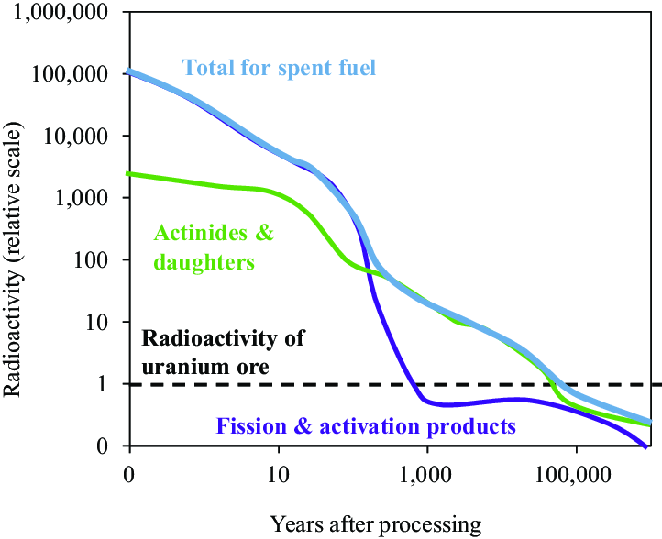
Result :

Slide 6
Discussion -
Insights :
AI can accurately predict the long-term behavior of radioactive waste, which is crucial for improving safety protocols.
The model could help identify risks in the storage facilities before they become catastrophic.
Improved classification of waste types allows better disposal strategies to be implemented.
Challenges Faced :
Data scarcity in certain areas (like low-volume waste).
Ensuring the accuracy of models given the unpredictable nature of some radioactive materials.
Difficulty in gathering sufficient environmental data for training models.

Slide 7
Solution Impact :
Sustainability Impact:
The model contributes to more sustainable radioactive waste management by reducing the environmental footprint of waste disposal and improving long-term containment.
AI can help ensure that waste is managed in an environmentally responsible way by predicting when and where containment may fail, preventing environmental contamination.
Practical Implementation:
AI can be implemented in waste management facilities to monitor and predict risks in real-time.
It can help optimize waste storage, reducing the costs and risks associated with maintaining hazardous waste sites.
Collaboration with environmental regulators and authorities can enhance waste safety.

Slide 8
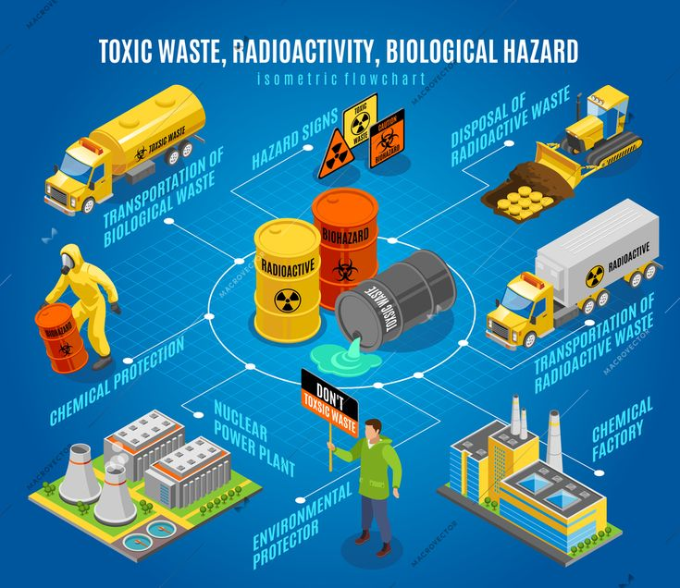
Flow Chart :
Fig : Radio - Active Waste Model

Slide 9

Conclusion
Summary:
AI presents a transformative opportunity to manage radioactive waste more effectively by predicting its behavior and improving containment systems.
Through predictive models and anomaly detection, AI can optimize waste disposal strategies, reducing human error and environmental risk.
Future Work:
Integrating more real-time data from sensor networks and environmental monitoring systems for dynamic waste management.
Exploring the use of reinforcement learning to improve decision-making in waste management systems.
Expanding the dataset to include international standards and case studies from various waste types.

Slide 10
References:
Include references to journals, articles, or research papers that have explored AI applications in waste management, radioactive decay modeling, or similar fields.
Cite sources on machine learning methodologies used in this domain, including textbooks, conference papers, or research findings.

Slide 11
Thank You
Notes:
Thank You !!

